Slide 1

Artificial intelligence
Hossam Elsayed MohaMED Fakher
0 1 2 7 7 8 8 0 6 7 8
Gmail
GitHUB
Linkedin
Kaggle
S e s s i o n 6
Segmentation

Slide 2
R-CNN
• Scan the input image for possible objects using an algorithm called Selective Search, enerating ~2000 region proposals.
• Run a convolutional neural net (CNN) on top of each of these region roposals.
• Take the output of each CNN and feed it into
an SVM to classify the region
a linear regressor to tighten the bounding box of the object if such an object exists.

Slide 3
R-CNN

Slide 4
Fast R-CNN
• The purpose of the Fast Region-based Convolutional Network (Fast R-CNN) is to reduce the time consumption related to the high number of models necessary to analyze all region proposals.
• Performing feature extraction over the image before proposing regions, thus only running one CNN over the entire image instead of 2000 CNN’s over 2000 overlapping regions.
• Replacing the SVM with a softmax layer, thus extending the neural network for predictions instead of creating a new model.

Slide 5
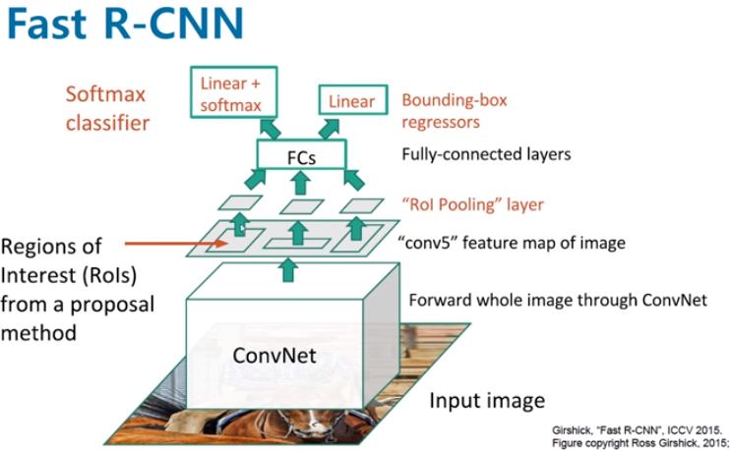
Fast R-CNN

Slide 6
Faster R-CNN
• The input image is passed through a pre-trained CNN (The original Faster R-CNN used VGG), then we use the convolutional feature map we get for the next part.
• Next, the Region Proposal Network (RPN) uses the features that the CNN computed to find up to a predefined number of regions (bounding boxes), which may contain objects. It generates multiple possible regions based on k fixed-ratio anchor boxes (default bounding boxes). RPN accelerates the training and testing processes.
• Finally, comes the R-CNN module, which uses that information to: Classify
the content in the bounding box (or discard it, using “background” as a label). Adjust the bounding box coordinates (so it better fits the object).

Slide 7
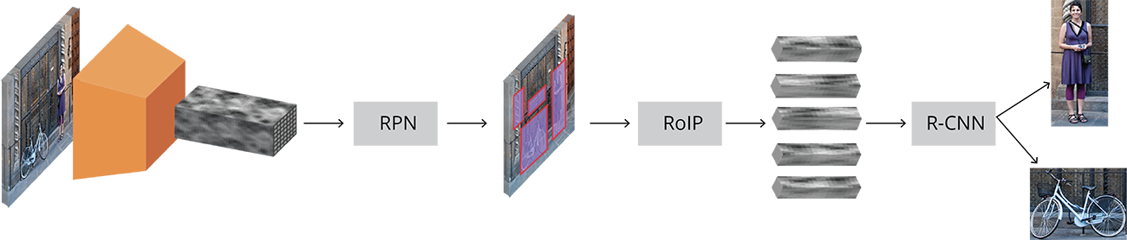
Faster R-CNN

Slide 8
Mask R-CNN
Mask R-CNN (Mask Regional Convolutional Neural Network) is a state of the art model for instance segmentation, developed on top of Faster R-CNN.
For a given image, Mask R-CNN, in addition to the class label and bounding box coordinates for each object, will also return the object mask.

Slide 9
Mask R-CNN

Slide 10
Comparison Between Models

Slide 11
Detectron2
• Detectron2 was built by Facebook AI Research (FAIR) to support rapid implementation and evaluation of novel computer vision research.
• Detectron2 is now implemented in PyTorch.
• Detectron2 is flexible and extensible, and able to provide fast training on single or multiple GPU servers.
• Detectron2 can be used as a library to support different projects on top of it.

Slide 12
Detectron2 Model Zoo
Detectron2 Model Zoo : https://github.com/facebookresearch/detectron2/blob/master/MODEL_ZOO.md

Slide 13
Detectron2 - Inference

Slide 14
Instance Segmentation on a custom dataset
labelme

Slide 15
Train Detectron2 On A Custom Dataset
Convert your data-set to COCO-format
The COCO dataset is formatted in JSON and has five annotation types: object detection, keypoint detection, stuff segmentation, panoptic segmentation, and image captioning. It is a collection of “info”, “licenses”, “images”, “annotations”, “categories” (in most cases), and “segment info” (in one case).

Slide 16
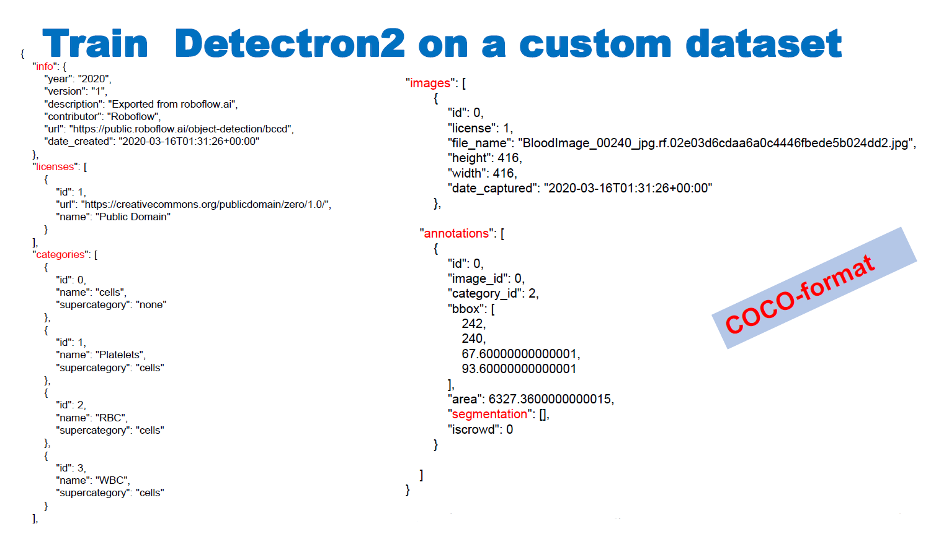

Slide 17
Train Detectron2 On A Custom Dataset

Slide 18
Train Detectron2 On A Custom Dataset
• Detectron2 keeps track of a list of available datasets in a registry, so we must register our custom data with Detectron2 so it can be invoked for training.
# Register Custom Detectron2 Data
from detectron2.data.datasets import register_coco_instances
register_coco_instances("my_dataset_train", {}, "/content/my_dataset/train/_annotations.coco.json",
"/content/my_dataset/train")
register_coco_instances("my_dataset_val", {}, "/content/my_dataset/valid/_annotations.coco.json",
"/content/my_dataset/valid")
register_coco_instances("my_dataset_test", {}, "/content/my_dataset/test/_annotations.coco.json",
"/content/my_dataset/test")

Slide 19
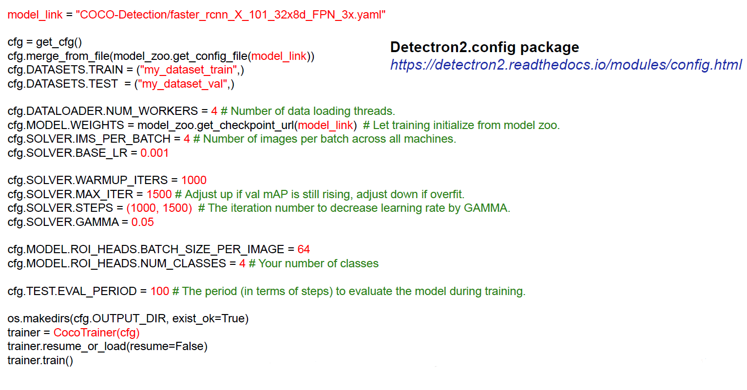
Train Detectron2 On A Custom Dataset

Slide 20
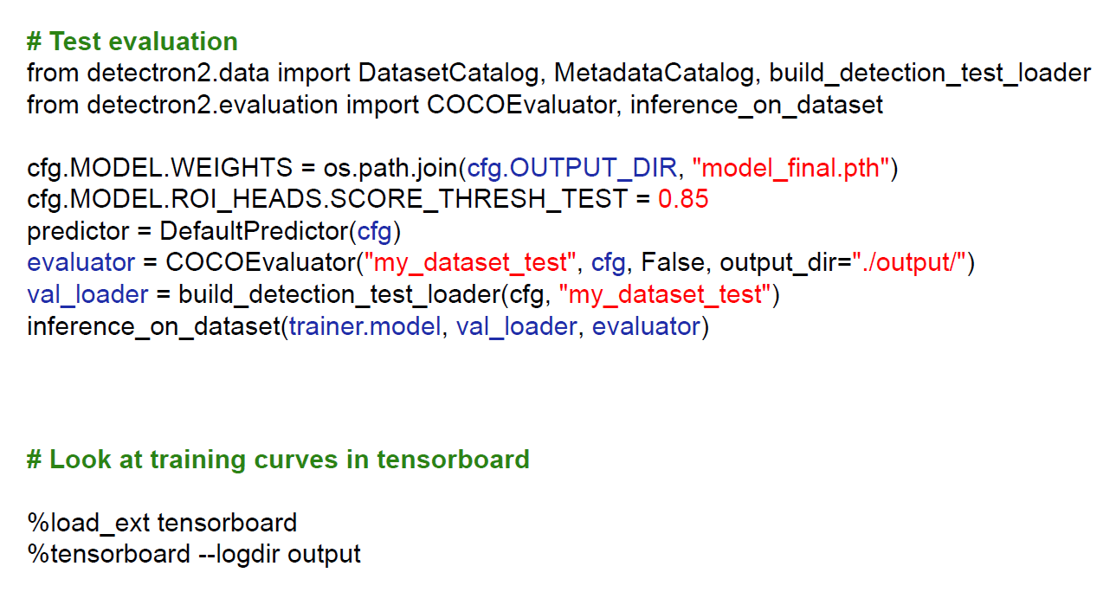
Train Detectron2 On A Custom Dataset

Slide 21
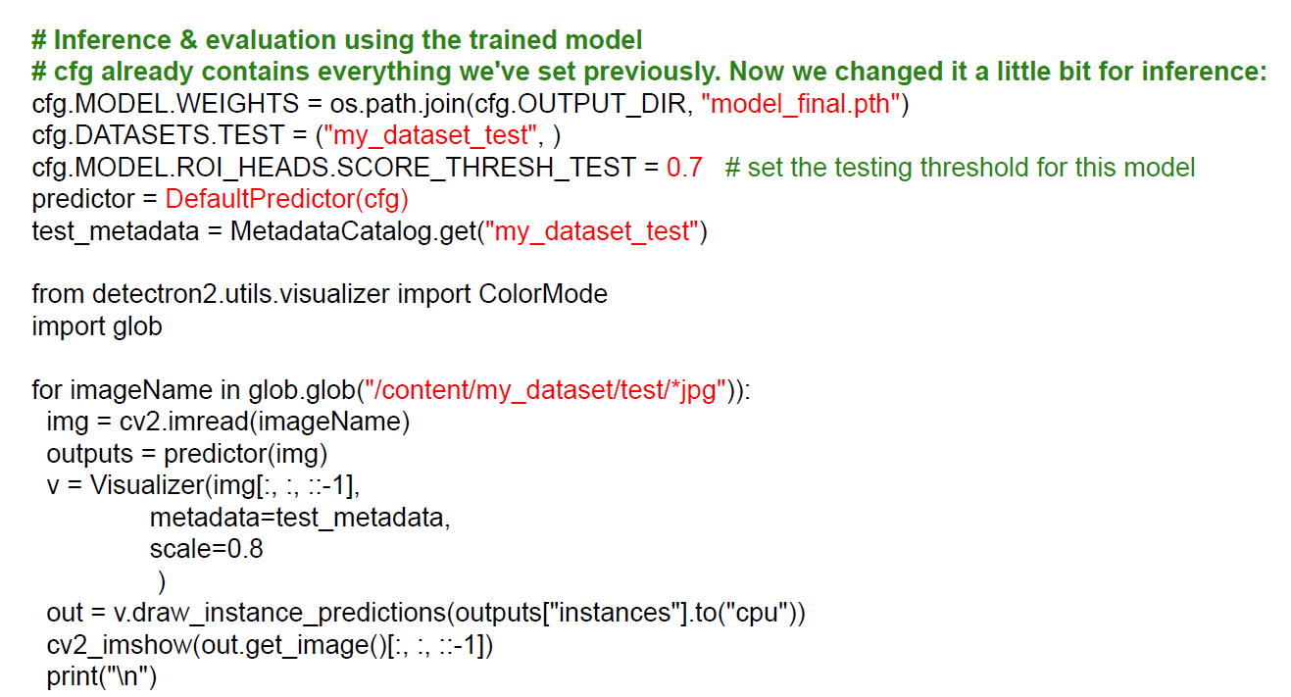
Train Detectron2 On A Custom Dataset

Slide 22
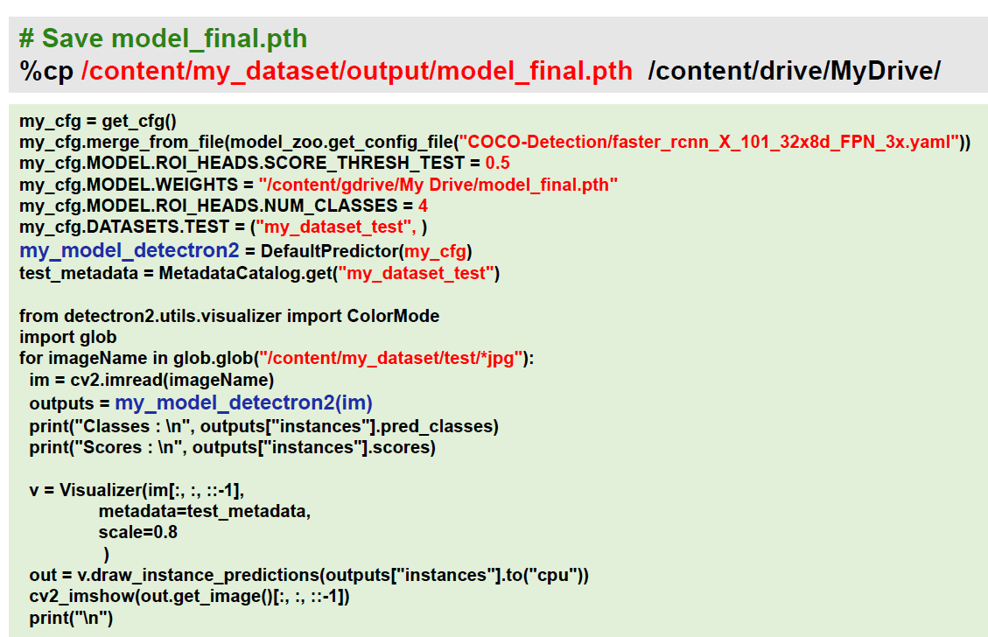
Train Detectron2 Save/Load Trained Model

Slide 23
Thanks for listening

